Slide 1


Research and Application of DNA Sequence Compression Algorithm
Based on FASTA File
Yuanjie Hu Yichun Cai
Zhinuo Zhou Yuyue Zhu
June 7. 2021

Slide 2
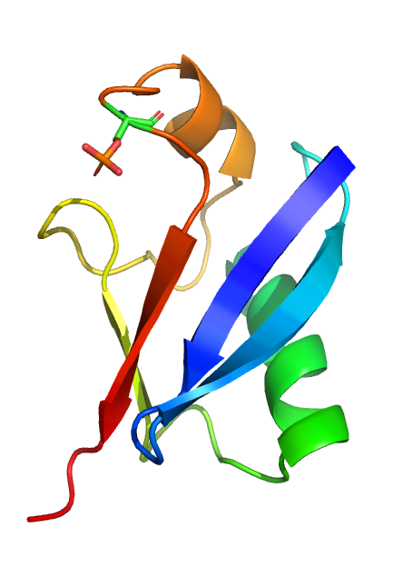
Source topic
BI290 Course Project Proposal 1：
Biological sequence compression algorithms
LEARN MORE

Slide 3

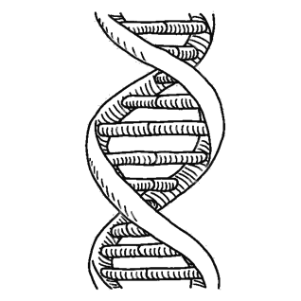
ABOUT DNA
ABOUT DNA
The DNA sequence consists of 4 bases, A (adenine), C (cytosine), G (guanine) and T (thymine). Two bits are enough to represent each base.
Approximate, reverse, complementary, reverse complementary, and tandem.The repetition time is very long and the frequency is low.
ABOUT FASTQ
ABOUT ALGORITHM
Three types of data generated by sequencing are stored in the FASTQ file, namely short read sequence, identifier sequence and quality sequence
Lossless compression
lossy compression
Notes:
近似、反向、互补、反向互补、串联。重复时间很长，频率低。
FASTQ文件中存储了测序产生的三类数据，即短读序列、标识符序列和质量序列

Slide 4

BACKGROUND
1. Use appropriate data types and use the fewest bits to store data;
2. Use one data to represent the repeated data string;
3. Use a data to represent a long string according to a certain rule
1、Combine the Markov model with the idea of random rounding
2、According to the data rate distortion theory
3、Through non-uniform quantification of quality scores
Lossless compression
Lossy compression
Notes:
1、结合马尔可夫模型和随机舍入的思想
2、根据数据率失真理论
3、通过质量分数的非统一量化

Slide 5
THREE IMPORTANT ALGORITHMS
DNA sequence compression algorithms are divided into two types: lossless and lossy, which may be vertical, horizontal or standard modes.
In this research, we mainly implement two algorithms to losslessly compress DNA sequences：
Optimal Seed Based Compression Algorithm
SeqCompress Algorithm
Hoffman encoding and decoding Algorithm
Use arithmetic coding and statistical models to compress sequences
Compare the results with the results of basic research algorithms
Utilize the inherent repetitive structure to create an offline dictionary containing all repetitions and mismatch details.

Slide 6

EXXXXXXxperiment
LEARN MORE

Slide 7
THREE IMPORTANT ASPECTS
In this part, we conduct experiments from three aspects to find the best algorithm results.
WEfficiency
WRunning speed
WNew algorithm
algorithm1
Improve efficiency by adjusting parameters
algorithm2
Improve algorithm speed through multithreading and vector
algorithm3
Hoffman algorithm provides comparison

Slide 8
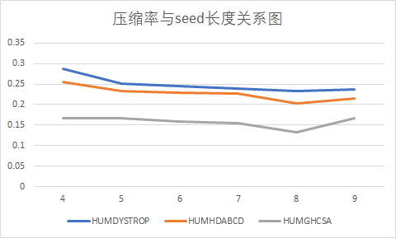
Experiment 1
Improve efficiency by adjusting parameter: 8 is the best s

Slide 9
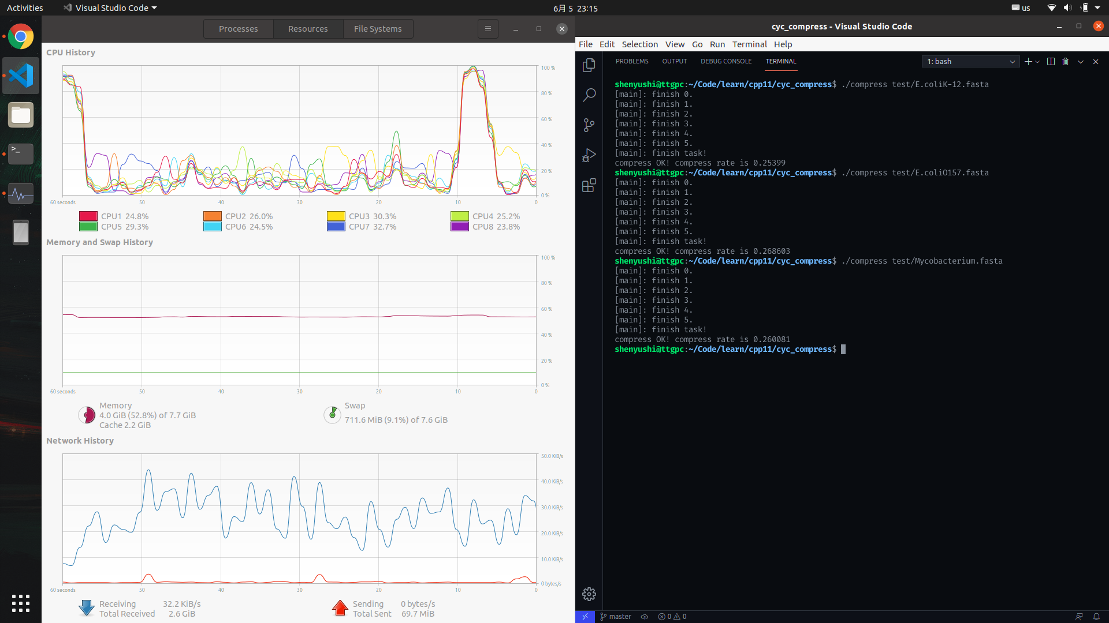
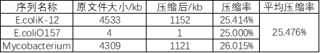
Experiment 2
Improve algorithm speed through multithreading and vector in cc

Slide 10
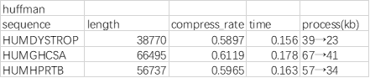
Experiment 3
Hoffman algorithm provides comparison

Slide 11
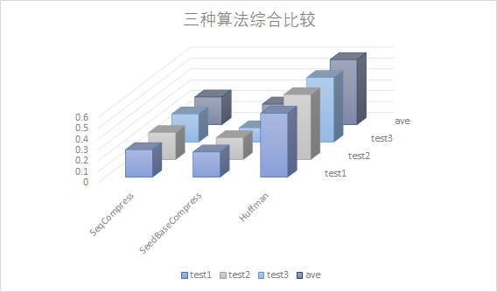
SUMMARY OF RESULTS
Comprehensive comparison of the efficiency of the three algorithms

Slide 12
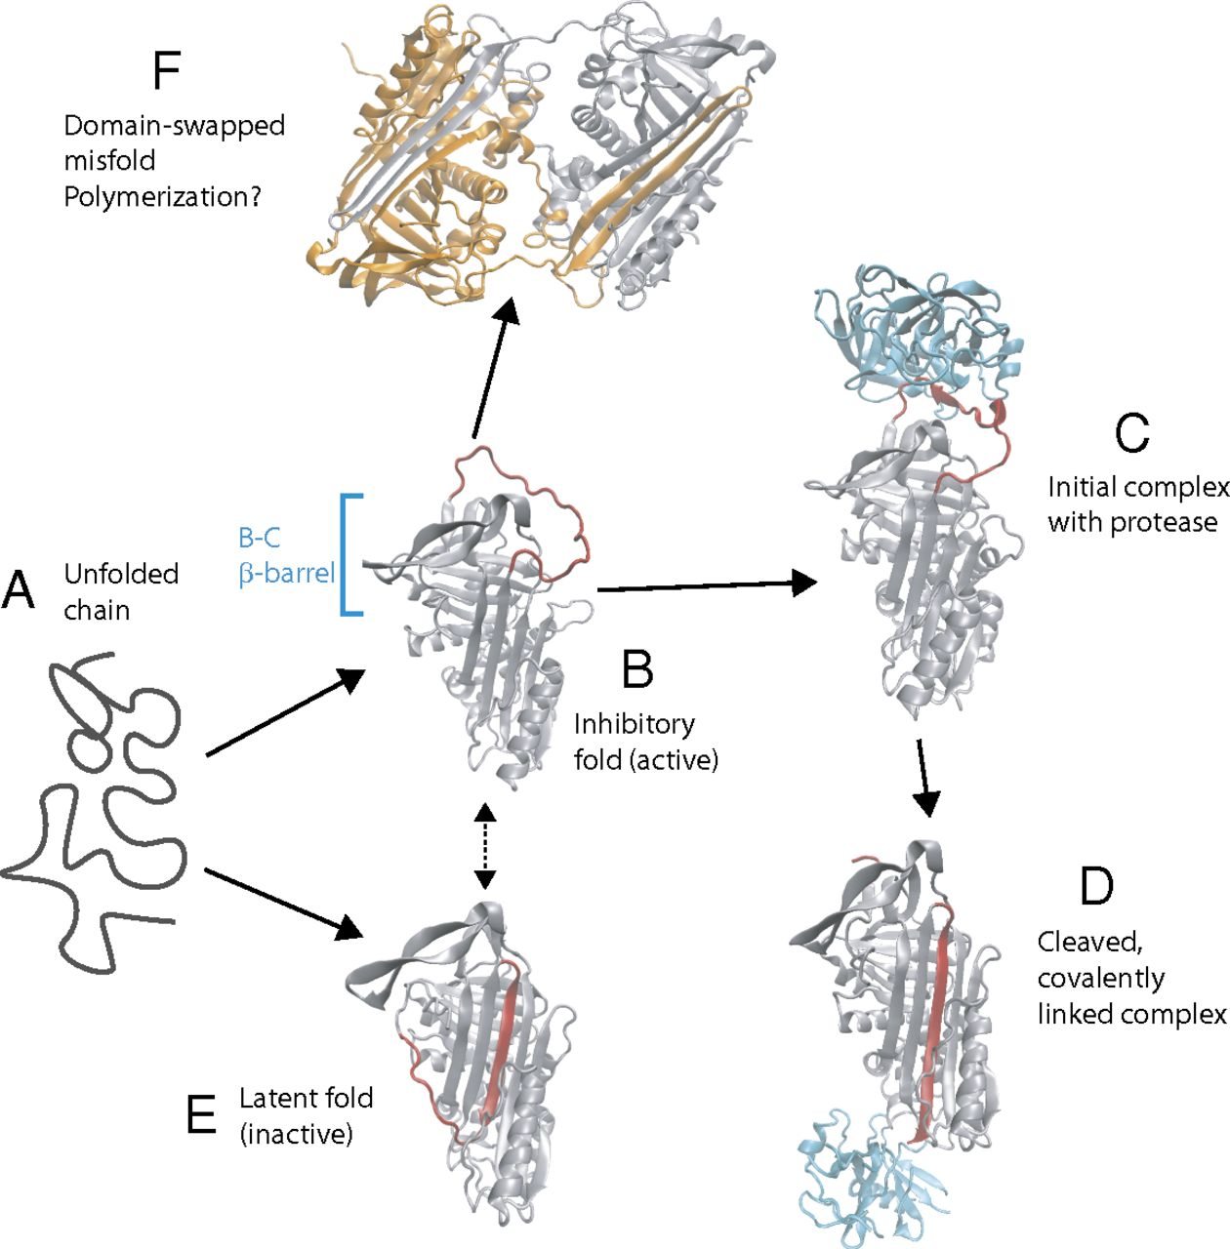
CONCLUSION

Slide 13
CONCLUSION
WWWW We have compiled three algorithms for DNA sequence compression, and all have obtained the expected experimental results.
SeedBaseCompress——high efficiency
Search for higher efficiency by adjusting the seed length (parameter adjustment). The result is the best when the value is 8, and the compression rate is approximately 20%.
WSeqCompress
SeqCompress——high running speed
Improve algorithm speed through multithreading and vector.
The average compression rate is approximately 25.476%, the compression effect is relatively ideal.
WSeedBase
Compress
WHoffman
Hoffman——new and as a comparison
As a comparison algorithm, the time-consuming is short but the compression effect is not good, the average is 60%.

Slide 14
FUTURE IMPROVEMENT
A
B
C
D
Use more efficient sequence prediction algorithms and compression coding methods
Introduce the biological information and biological interpretation of the sequence into the algorithm
Develop more targeted DNA sequence compression algorithms
Effective packaging management of compressed data
Notes:
使用更高效的序列预测算法和压缩编码方法
将序列的生物学信息和生物学解释引入算法
开发更有针对性的DNA序列压缩算法
压缩数据的有效打包管理

Slide 15


Yuanjie Hu Yichun Cai
Zhinuo Zhou Yuyue Zhu
June 7. 2021

